Slide 1
Security Scan for OpenStack
Demo 1
2 February 2018
Clara De Paolis
Dilip Makwana
Hao Wu
Chi Zhang

Slide 2
Background
Trilio
provides business assurance platform for IT organizations and cloud service providers deploying application workloads in the cloud
backup services native for OpenStack environments
Backups are performed without interrupting running workloads.

Slide 3
Goals
Develop a security scan system for OpenStack backup image files.
Specifically scan for QCOW2 format
Based on existing scanning tools
Libguestfs, for load VM images
VMInspect, inspecting VM disk images
Perform security scan on the images using common security tools
CVE-Search
a tool to import Common Vulnerabilities and Exposures into a MongoDB for searching and processing CVEs
Nessus & Open VAS
Vulnerability scanners for live servers
Bandit
Static analyzer for Python code
Minimum Viable Product
Scan the snapshots for security purposes and prepare reports to show the clients the vulnerabilities
Ideally, showing scanning results using data visualization technologies in the web form

Slide 4
Evaluation
Minimum acceptance criteria is to build the service which identifies the vulnerabilities with given snapshots.
Support scanning on one QCOW2 format snapshot
Scanning using at least one Common Vulnerabilities and Exposures (CVE) database for our scanning reference
Show the client scanning results with texts and other stats
Stretch goals:
Support scanning on multiple snapshots simultaneously
Use multiple CVE databases for scanning references
Having a user-friendly front-end page for displaying results and better user interactions.

Slide 5
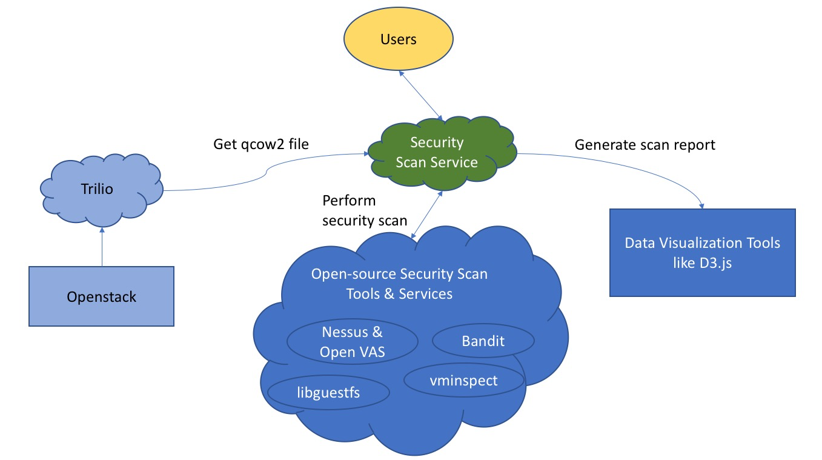
Solution
Key Components:
Users
OpenStack dashboard - dashboard to configure OpenStack
Trilio Service/Plugin - plugin of the service we are building (responsibility of our project)
Cloud VM Snapshot - backup image file taken by Trilio from the client
Vulnerability Databases (e.g., NVD) - Database to be access by service for Vulnerabilities
Scanning tools
Data Visualization Tools - e.g. D3.js

Slide 6
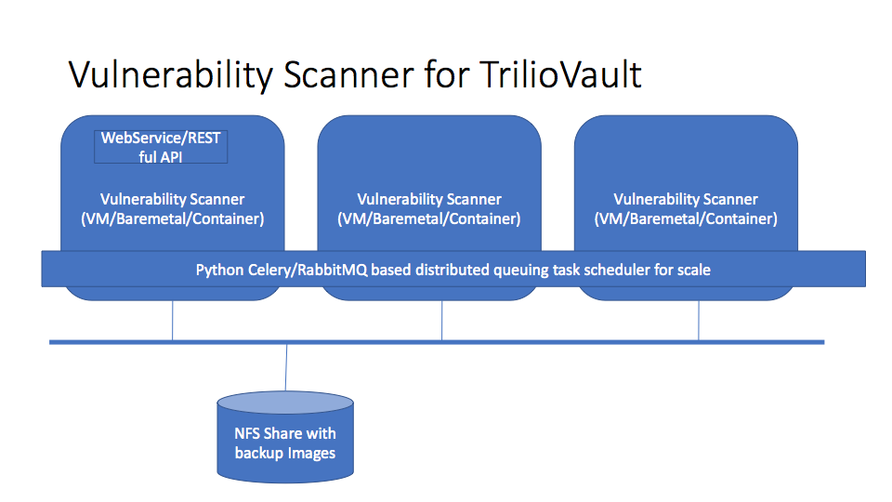

Slide 7
Details
Functionalities of Security Scan Service:
Showing the detectable files in the snapshot
Size
Path
Sha1
Type
Identify known malwares in the snapshot
Query 3rd party services to check the eligibility of a file in the snapshot
E.g., VirusTotal
Scan applications using 3rd party CVE databases
Showing event logs in the snapshot
Also find possible vulnerabilities in the logs

Slide 8
Timeline
Sprint 1
Sprint 2
Sprint 3
Sprint 4
Sprint 5
Sprint 6
Sprint 7
Accessing Trilio Backups
Vulnerability scanning
Evaluate scans
API implementation
Report generation and presentation
Final improvements
Planning
Generate a user friendly report based on the scanning result using data visualization tools
1. Project proposal
2. Identify Service goals/requirements
3. Research related security scanning technologies, libraries, and tools.
1. Set up a POC environment on Mass Open Cloud
2. Access snapshots and understand how to work with the POC environment
3. Design API standard based on Trilio’s
1. Scan snapshots to understand cloud environment when snapshot was taken
2. Aggregate scanning results from different vulnerability databases
Evaluate different vulnerability scanners that were tested in previous sprint
Implement and test RESTful API designed in sprint 2

